Slide 1

Chinwendu Emelumba
Data Analytics Portfolio

Slide 2
Content Outline
About Me
Projects
GameCo. Video Game Sales
Influenza Season – Are You Prepared?
Rockbuster Stealth LLC: A Data-Driven Launch Strategy
Instacart Grocery Basket Analysis
Pig E. Bank Analysis
Understanding Happiness: A Global Perspective (WHR 2023)
Contact Me

Slide 3


About Me
Hello! I am a newly-certified data analyst with a strong background in medicine and the natural sciences. In addition to spending a number of years working in the area of Emergency Medical Services and more broadly in the health field in different capacities, I acquired both an undergraduate degree in Biology (with a minor in Chemistry) and a masters degree in Biomedical Sciences. I was on track for a career in medical practice when I withdrew from my medical school program during my clinical rotations year (3rd year of D.O. program) for an alternative career path. For me, that alternative career path is in the tech field and data analytics is my point of entry. Since I retain a broad interest in medicine and the natural sciences, I am chiefly interested in serving in a data analytics role for a company or organization operating in related areas, such as biotech, pharmaceuticals, health insurance, and hospitals/health systems. However, I am very open to opportunities to employ my newly acquired analytics toolkit for a company outside of the STEM+M fields.

Slide 4
Projects

Slide 5
GameCo. Video Game Sales (Project #1)

Slide 6
Project Components
Company Objective: Fostering a better understanding how new GameCo. Games may perform in the market
Analyst Role:
As a data analyst for the video game company, GameCo, (*faux company), I was tasked with drawing insights from video game data through descriptive analysis guided by the following key questions:
Are certain types of games more popular than others?
What other publishers will likely be the main competitors in certain markets?
Have any games decreased or increased in popularity over time?
How have their sales figures varied between geographic regions over time?

Slide 7
Project Components (Contd.)
Data Set:
The data set is a record of historical sales of games from a variety of platforms, genres and publishing studios. This record was drawn from VGChartz.
The video game sales data set may be downloaded here: VGSales Data Set
For an understanding of the approach used to gather and correlate the data, please see the following resource: VGChartz Methodology
Tools Used:
Microsoft Excel, Powerpoint

Slide 8
Project Components (Contd.)
Skills developed:
Cleaning, Grouping and Summarizing Data
Building pivot tables
Building bar and column charts, box and whisker plots, scatter plots
Telling an analytical story through a presentation about the analysis performed and the insights produced

Slide 9
Project Components (Contd.)
Fig.1: Data At a Glance – Trends to Note
Steps Taken to Fulfill Analyst Role:
Given that the working assumption of GameCo. Executives was that there had been no changes in sales trends in the geographic regions to which their reach extended (viz. North America [NA], Europe [EU], and Japan [JP]), my first move was to conduct an exploratory analysis of the data in order to either confirm or disconfirm it. Based on my review of the data, I came to the conclusion that sales in the various geographic regions had actually varied significantly over time (Fig.1).
During my analysis, I also complied summary stats on sales in the various geographic regions as well as sales on a global scale. This also included an evaluation of sales performances at the level of video game genre (Fig.2)

Slide 10
Fig.2: Summary Stats
Project Components (Contd.)
Measures of Central Tendency | NA_Sales | Global_Sales
Mean | 0.24174 | 0.491385294
Median | 0.08 | 0.17
Mode | 0 | 0.02
Range | 41.49
Q3 | 0.24
Q1 | 0
IQR | 0.24
Outlier Values (Lower Limit - i.e. Outliers are below -0.36) | -0.36
Outlier Values (Upper Limit - i.e. Outliers are above 0.6) | 0.6

Slide 11
Project Components (Contd.)
Recommendations:
In the light of the findings from my analysis (GameCo. VGSales Analysis & Presentation), I made the following recommendations:
In order to maximize return-on-investment (ROI), GameCo. ought to consider aggressively marshalling marketing resources towards Shooter genre games in its largest market, viz. NA.
In order to maximize ROI, GameCo. ought to consider aggressively marshalling marketing resources towards Role-playing genre games in JP.
In order to maximize ROI, GameCo. ought to consider investigating the anomalous appearance of the EU sales performance outpacing that of NA in 2016. Understanding the reason for this departure from annual trends of the past five years may help GameCo. better determine how to allocate marketing resources for 2017 in EU and NA.

Slide 12
Influenza Season – Are You Prepared? (Project #2)

Slide 13
Project Components
Company Objective: Assisting medical staffing agency in determining when to send staff, and how many to each state in the U.S.
Analyst Role:
As a data analyst for a medical staffing agency, I was tasked with drawing insights from combined data from the US Census Bureau and the CDC to be used in the formulation of recommendations to be included in the development of a staffing plan with appropriate spatial and temporal distribution of medical personnel based on regional influenza trends and staffing demands.

Slide 14
Project Components (Contd.)
Analyst Role (Contd.):
My analysis was guided by the following additional considerations:
Determine whether influenza occurs seasonally or throughout the entire year. If seasonal, does it start and end at the same time (month) in every state?
Prioritize states with large vulnerable populations. Consider state categorization system such that each state is ranked as low-, medium-, or high-need based on its vulnerable population count.
Pay particular attention to influenza deaths, vulnerable populations, and (optionally) flu-shot rates—particularly in vulnerable populations—to determine medical staffing needs.

Slide 15
Project Components (Contd.)
Data Set(s):
Influenza deaths by geography
CDC_Influenza_Deaths_Dataset_edited.xlsx
Population data by geography, time, age, and gender
Census Population Dataset
Counts of influenza laboratory test results by state (survey)
CDC_Influenza_Visits.xlsx
CDC_Lab_Tests.xlsx
Survey of flu shot rates in children
NIS_Flu_Shot_Survey_reduced.xlsx

Slide 16
Project Components (Contd.)
Tools Used
Microsoft Excel, Tableau
Skills Developed
Designing a data research project beginning with the formulation of a research hypothesis
Data Transformation and Integration
Conducting statistical analyses and performing statistical hypothesis testing
Use of Tableau for data visualizations (temporal & statistical) as well as spatial and textual analysis

Slide 17
Project Components (Contd.)
Steps Taken to Fulfill Analyst Role:
Based on the data collected by the US Census Bureau and the CDC, I decided to begin my work with the following research hypothesis: If a person is greater than 65 years of age, then he/she is likely to have one or more chronic medical conditions that increases susceptibility to more severe symptoms of influenza infection and subsequent death from those symptoms. Consequently, lower rates of vaccination for this age group may result in an increased overall mortality rate.
With those over 65 years of age as my point of focus due to data availability and ease of analysis, I sought to acquire a sense of the number of deaths in this population due to influenza and represent it visually (Fig.1). I also tried to see if I could determine the distribution of those deaths in this population by state in the US (Fig.2).
With this information, I was able to determine the high-priority states with respect to staffing demand and based on information about the duration of flu season obtained from the CDC, I was able to determine that the staffing need might very likely be most acute during the months of November to April.

Slide 18
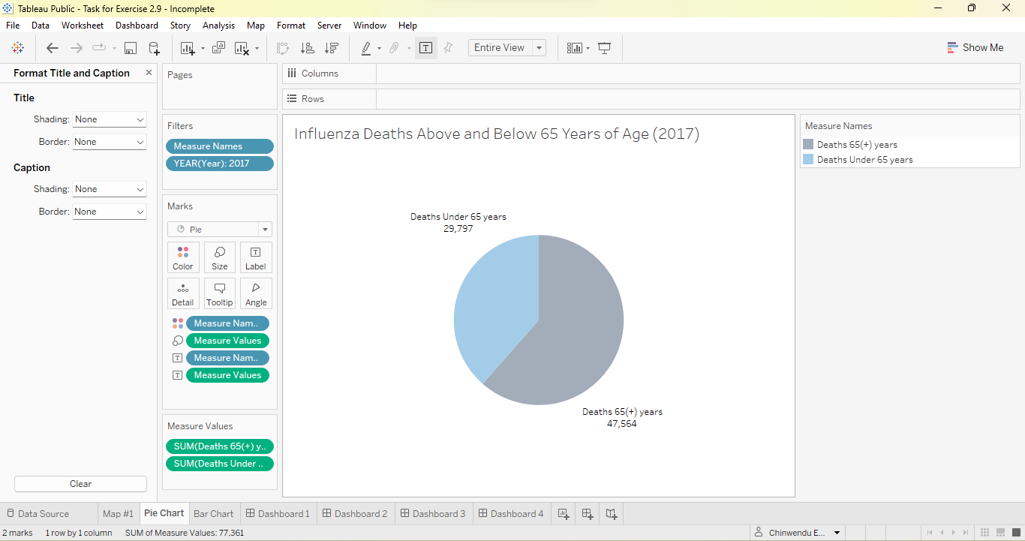
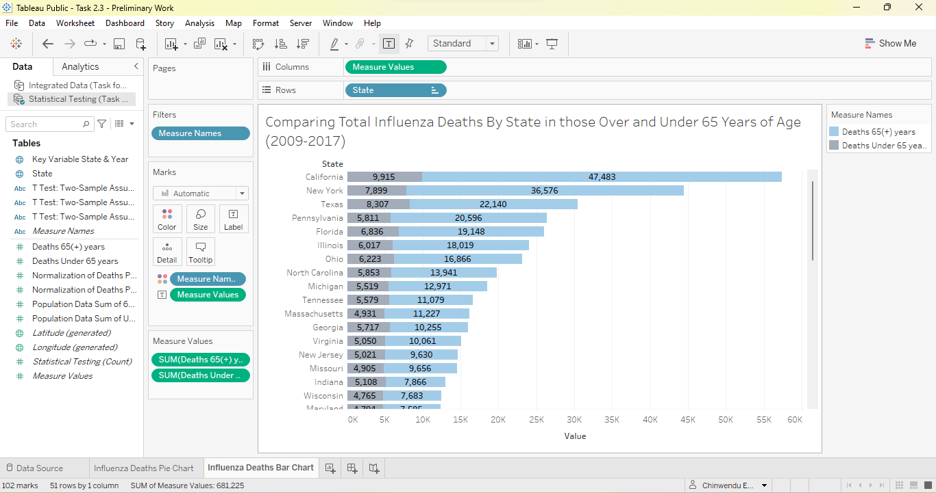
Project Components (Contd.)
Fig.1: Influenza Deaths of Individuals > and < 65 years of age
Fig.2: Comparing Total Influenza Deaths by State

Slide 19
Project Components (Contd.)
Recommendations:
In view of the analysis performed, I made the following recommendations:
High-priority states in supplying adequate staffing to health systems to contribute to hospital preparedness should be California, Florida, Texas, Pennsylvania and New York
Given that a significant factor impacting healthcare professional and patient ratios is patient volume, hospitals should consider strategies for not only mitigating the effects of high patient volumes during peak influenza periods (e.g. winter season) but also reducing overall patient volume.
I also added that initial considerations for reduction in patient volume should include:
Evaluation of staff vaccination policies
Consideration of public health information campaigns related to flu and flu vaccines
Incentivization of outpatient staff efforts to encourage patient reception of flu vaccines once available at the beginning of flu season (See the following for the full presentation: Influenza Season - Are You Prepared? | Tableau Public)

Slide 20
Rockbuster Stealth LLC: A Data-Driven Launch Strategy (Project #3)

Slide 21
Project Components
Company Objective: Use analytics to inform the development of a launch strategy for an online video rental service
Analyst Role:
As a data analyst hired to function as a member of Rockbuster Stealth’s Business Intelligence (BI) department, I was tasked with analyzing Rockbuster’s data and developing data-driven answers to the following series of business questions:
What movies contributed the most/least to revenue gain?
What was the average rental duration for all videos?
Which countries are Rockbuster customers based in?
Where are customers with a high lifetime value based?
Do sales figures vary between geographic regions?

Slide 22
Project Components (Contd.)
Data Set:
Rockbuster Data Set containing information that includes film inventory, customers and payments:
Rockbuster Stealth Dataset
Tools Used:
Microsoft Excel, SQL (specifically PostgreSQL), Tableau

Slide 23
Project Components (Contd.)
Skills Developed:
Acquiring familiarity with Online Analytical Processing (OLAP) Databases and Relational Database Management Systems (RDBMS)
Developing database querying ability in SQL
Filtering, cleaning and summarizing data in SQL
Learning data table joins (e.g. inner, outer), execution of subqueries and use of common table expressions (CTEs)

Slide 24
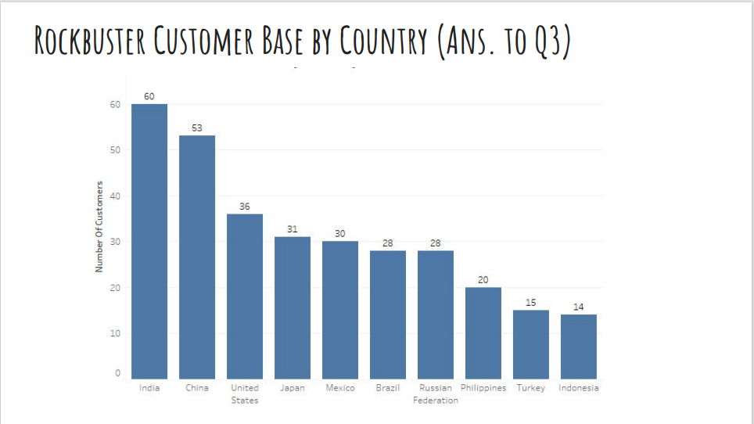
Project Components (Contd.)
Steps Taken to Fulfill Analyst Role:
As a first step to answering the questions of concern, I loaded Rockbuster’s data into a relational database management system (RBDMS). Then, SQL queries were used to analyze the data and derive a number of actionable insights, including the Rockbuster customer base by country (Fig.1) and sales performance with respect to genre and ratings (Figs.2 and 3).
Fig.1: Rockbuster Customer Base

Slide 25
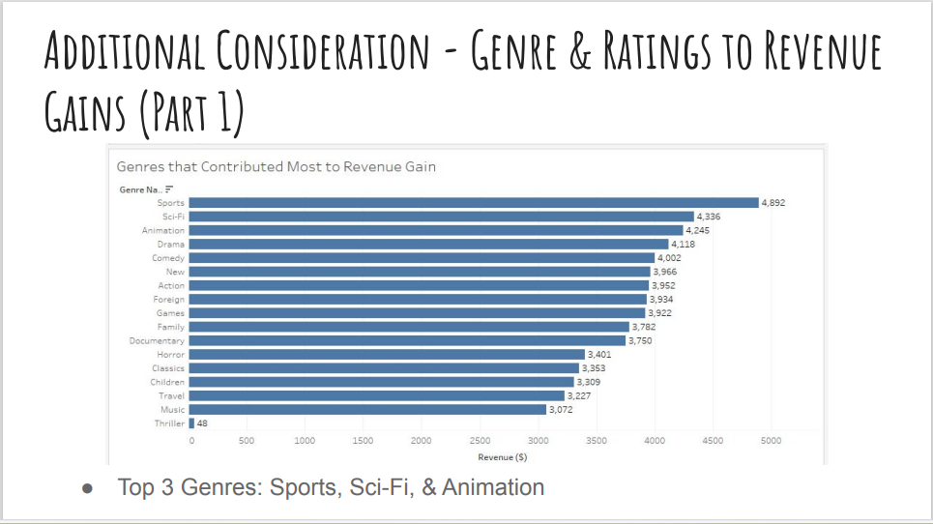
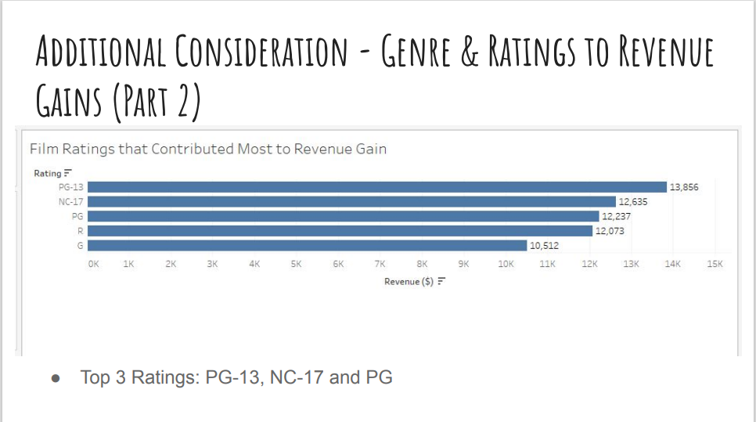
Project Components (Contd.)
Fig.2: Revenue Gains by Genre
Fig.3: Revenue Gains by Film Ratings

Slide 26
Project Components (Contd.)
Recommendations:
A concerted effort to direct film selection and marketing resources towards the top-performing movies in the categories of genre and rating. To re-cap, the specifics for each of the two aforementioned categories are as follows:
Genres: Sports (Top earner), Sci-Fi & Animation
Ratings: PG-13 (Top earner), NC-17 & PG
The geographic distribution of the RB customer base seems to suggest that the strategic increase and allocation of marketing resources to the following areas could potentially contribute to an increase in company revenue: (1) India (Top earner) (2) China (3) United States
Reconsider company presence in the lowest-performing countries. The three lowest performers were American Samoa (Lowest performer), Lithuania & Saint Vincent and the Grenadines (Click the following link for the full analysis and presentation: Rockbuster Stealth Analysis & Presentation).

Slide 27
Instacart Grocery Basket Analysis (Project #4)

Slide 28
Project Components
Company Objective: Increase product revenue via targeted marketing campaigns based on customer data
Analyst Role:
As a data analyst, I was tasked with conducting an initial data and exploratory analysis of customer data to derive insights that may be used by Instacart to perform targeted marketing campaigns. The analysis was bounded by the following key concerns:
The sales team needs to know what the busiest days of the week and hours of the day are (i.e. the days and times with the most orders) in order to schedule ads at times when there are fewer orders.
They also want to know whether there are particular times of the day when people spend the most money, as this might inform the type of products that they advertise at these times.
Instacart has a lot of products with different price tags. Marketing and sales want to use simpler price range groupings to help direct their efforts.

Slide 29
Project Components (Contd.)
Key Concerns (Contd.):
Are there certain types of products that are more popular than others? The marketing and sales teams want to know which departments have the highest frequency of product orders.
The marketing and sales teams are particularly interested in the different types of customers in their system and how their ordering behaviors differ. For example: (a) What’s the distribution among users in regards to their brand loyalty (i.e. how often do they return to Instacart)? (b) Are there differences in ordering habits based on a customer’s loyalty status? (c) Are there differences in ordering habits based on a customer’s region? (d) Is there a connection between age and family status in terms of ordering habits? (e) What different classifications does the demographic information suggest? Age? Income? Certain types of goods? Family status? (f) What differences can you find in ordering habits of different customer profiles? Consider the price of orders, the frequency of orders, the products customers are ordering, and anything else you can think of.

Slide 30
Project Components (Contd.)
Data sets:
Instacart Customer Data Set:
Instacart Customers Data Set
Tools Used:
Microsoft Excel, Python
Skills Developed:
Development of Jupyter Fundamentals and Coding using basic Python data types
Data Wrangling and Subsetting
Performing data consistency checks, merging dataframes, deriving new variables and grouping/aggregating data
Data Visualization with Python

Slide 31
Project Components (Contd.)
Steps Taken to Fulfill Analyst Role:
I began by importing the data sets I would be using for my analysis into Jupyter notebook, using libraries like pandas, numpy, os, matplotlib, scipy and seaborn to facilitate the accomplishment of my analytical aims. The two sources for the data sets were Instacart (open-source data) and CareerFoundry (Faux Customer Data Set).
Using Python, these data sets were cleaned and ultimately merged into one data set. Through this process, I was able to isolate the variables of interest for the analysis and use the results for deriving any new columns relevant to the needs of my analysis as dictated by the key questions of importance to Instacart.
Next, I created at least four types of visualizations for communicating my analytical insights to stakeholders (See Figs. 1 and 2).
Finally, due to the size of this project, I created a project folder containing all the relevant components and results of my analysis that I wanted to make available to stakeholders. This included a final report documenting various insights and recommendations for action.

Slide 32
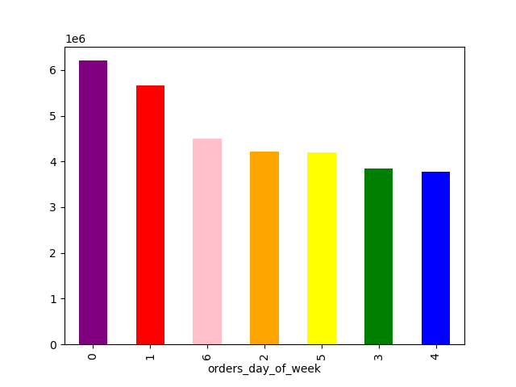
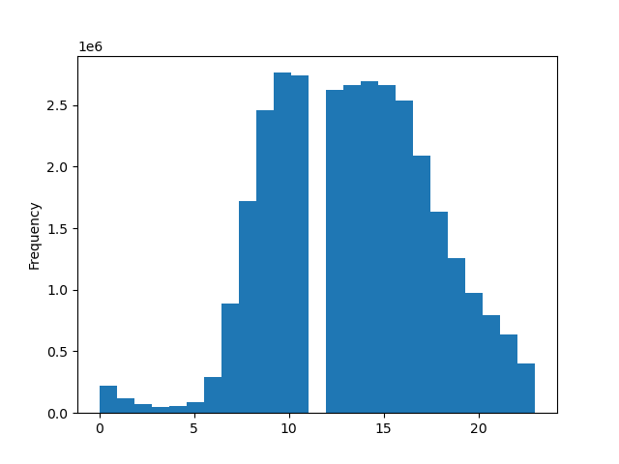
Project Components (Contd.)
Fig.1: Busiest days of the week for orders (*Y-axis
represents ‘Number of Orders’)
Fig. 2: Times of the day when customers spend the
most money (*X-axis represents ‘time_of_day’)

Slide 33
Project Components (Contd.)
Recommendations:
Due to constraints upon space, I will provide the link for a more comprehensive look at the analysis conducted with its derivative recommendations here: Instacart Grocery Analysis
With the remaining space, I will provide just two of the recommendations established based on the analysis reflected in this project. It ought to be noted that these take the form of direct responses to the key questions guiding the analysis that were articulated on an earlier slide:
Given that Saturdays and Sundays together with the weekday hours of 9-5PM were found to be the busiest days and times of the week, in terms of orders, respectively, it was determined that advertised hours and days would be most effective scheduled outside those windows. Specifically, this meant a recommendation that marketing/advertising teams ensure that ads be scheduled for weekday evenings after 5 PM for maximal impact on consumer/customer behavior.
Given that it was found that customers spend the most money on products during the late morning hours of 9-11AM, it was recommended that the marketing/advertising teams consider the possible returns from advertising some of their most popular products during these hours. Of course, there must also be an accounting for the data seeming to indicate that the hours in which ads may yield the highest impact of on customer behavior lies outside that window.

Slide 34
Pig E. Bank Analysis (Project #5)

Slide 35
Project Components
Company Objective: The Pig E. Bank anti-money-laundering compliance department is seeking assistance in the assessment of client and transaction risk as well as a clear strategy for increasing efficiency in running the bank’s compliance program.
Analyst Role:
As a data analyst, I was tasked with providing analytical support for efforts in assessing client and transaction risk as well as building and optimizing models for the bank’s aim to enhance the quality of its compliance program.

Slide 36
Project Components (Contd.)
Data Set:
Pig E. Bank Customer Data Set (There are also examples of data cleaning, extraction and the creation of a decision algorithm):
Pig E. Bank Customer Data Set
Tools Used:
Microsoft Excel, GitHub
Skills Developed:
Fundamentals of Data Mining
Basics of Predictive Analysis (Logistic vs. Linear Regression Models)
Time-Series Analysis and Forecasting
Using GitHub as an Analyst

Slide 37
Project Components (Contd.)
Steps Taken to Fulfill Analyst Role:
The first data-related project in which I took steps towards meeting Pig. E. Bank’s objective was focused on customer retention. Customer/Client data supplied by Pig E. Bank was cleaned and descriptive statistics were derived for use in understanding the data. This was all done towards the goal of identifying top risk factors for customer departure from the bank. Once all the necessary work was completed using things like pivot tables on Excel, a decision tree was created in the identified risk factors were modeled (See Fig. 1). The tree is a useful algorithm for Pig E. Bank to determine best points of interception along the customer pathways to departure.

Slide 38
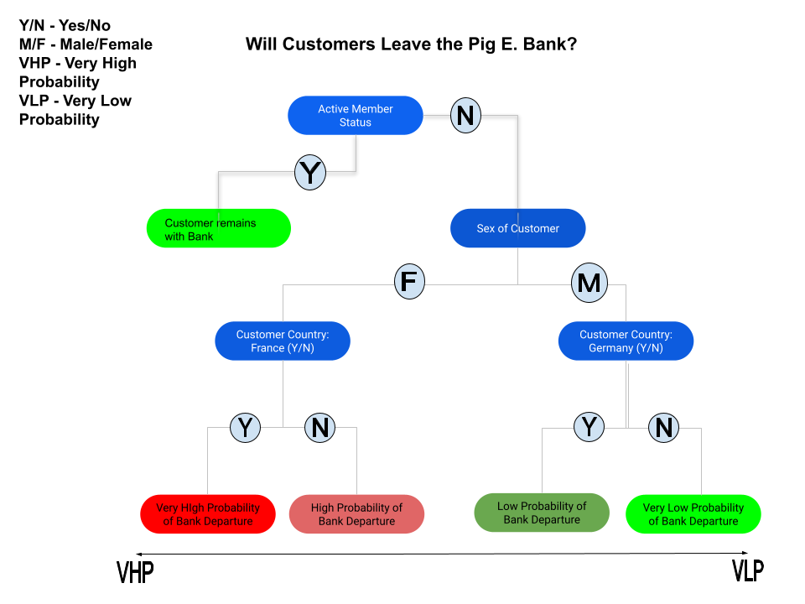
Project Components (Contd.)
Fig.1: Decision Tree for Customer Departures

Slide 39
Project Components (Contd.)
Recommendations:
While the nature of this project did not include the provision of recommendations (See the following for project file: Pig E. Bank Analysis), it would be advisable for Pig E. Bank, based on the analysis conducted, to track customers/clients with an inactive member status who are female and live in France. Measures may be considered for decreasing the likelihood that these clients/customers from active to inactive member status.

Slide 40
Understanding Happiness: A Global Perspective (WHR 2023) (Project #6)

Slide 41
Project Components
Company Objective: N/A
Analyst Role:
As a data analyst, I was tasked with finding and analysis a dataset that I would use to tell a story using the visualization skill that I developed in the use of Tableau during this course. That data set was from The World Happiness Report (WHR).

Slide 42
Project Components (Contd.)
About the Data:
The World Happiness Report (WHR), which is “…a partnership of Gallup, the Oxford Wellbeing Research Centre, the UN Sustainable Development Solutions Network, and the WHR’s Editorial Board” (World Happiness Report Data Dashboard | The World Happiness Report). Since its first presentation in April of 2012, The World Happiness Report, has been an instrument for informing various national governments and the interested public about the emerging evidence of the science of happiness and the current state of happiness in the world. The dataset from the WHR 2023 report was the focus of my analysis. (WHR 2023 Data for Table 2.1.xls (*Data set of choice))

Slide 43
Project Components (Contd.)
Tools Used:
Microsoft Excel, Jupyter notebook (Python), Tableau, GitHub
Skills Developed:
Sourcing Open Data
Geographical Visualizations with Python
Supervised Machine Learning: Regression
Unsupervised Machine Learning: Clustering
Sourcing & Analyzing Time Series Data

Slide 44
Project Components (Contd.)
Steps Taken to Fulfill Analyst Role:
As indicated earlier, I sourced the data from The World Happiness Report, using their data set for the 2023 report. Since the report measured happiness by a scale called the Cantril Ladder (a.k.a Life Ladder) in relationship to six variables (Log GDP per capita, Social Support, Freedom to make life choices, Generosity, Perceptions of corruption, and Healthy life expectancy), I focused mainly evaluated relationships between these variables. I also looked at relationships between some of the variables and the Life Ladder score. Much of this analysis occurred in Python and various visualizations were created as part of my overall analysis including scatterplots, pairplots (See Fig.1) and categorical plots. I also performed regression and time-series analysis of my data.

Slide 45
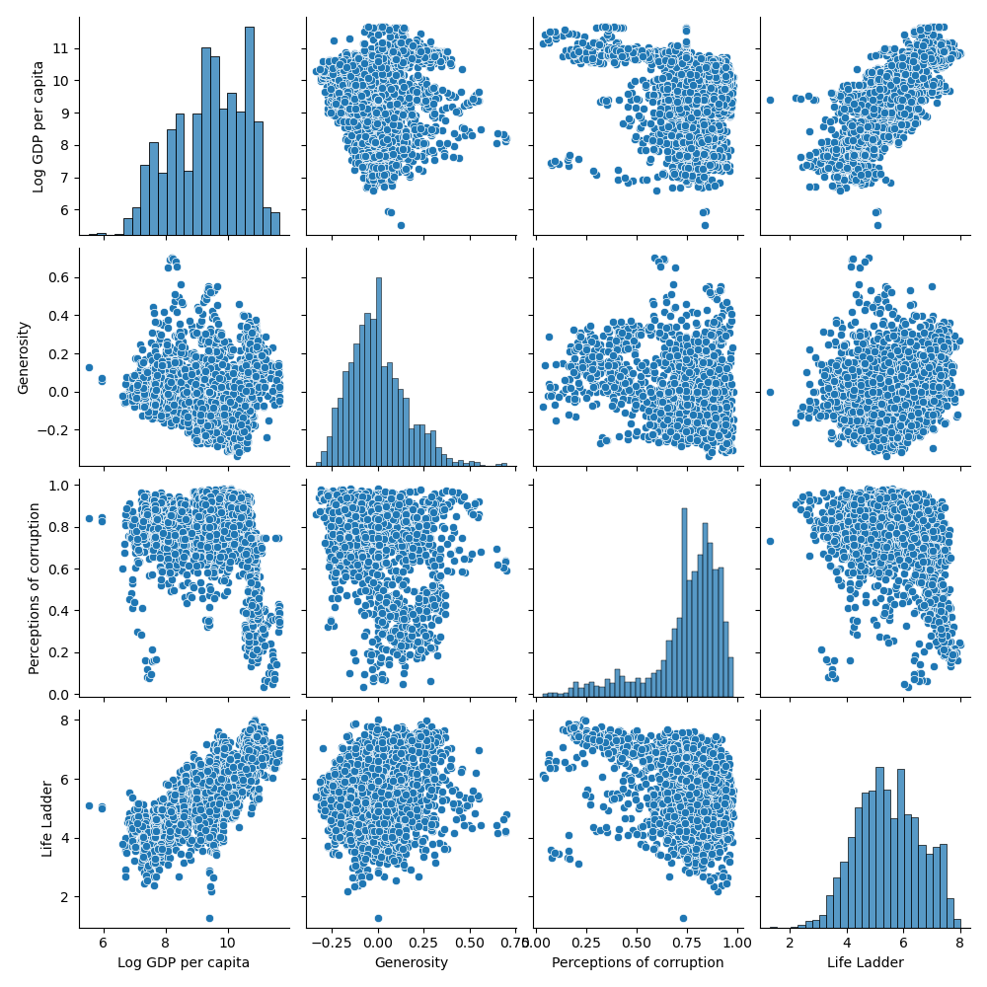
Project Components (Contd.)
Fig. 1: Pairplot of Log GDP per capita and other variables of interest

Slide 46
Project Components (Contd.)
Recommendations:
Here is a sample of at least two recommendations that were made based on the analysis performed for this project:
The negative correlation between Perceptions of corruption and Log GDP per capita, though expected, warrants investigation into anti-corruption policies/laws and additional measures for creating accountability and restraint; especially in countries with very low Log GDP per capita and high Perceptions of corruption (e.g. Venezuela as identified in earlier analysis).
The rapid transformation in the Log GDP per capita for the country of Venezuela is a story to be further unpacked. Analysis involving forecasting about its Life Ladder score relative to the Log GDP and the other dependent variables used to evaluate happiness should be explored for utility in informing the approaches of other governments investigating pathways for the improvement of the happiness of their people.
For a more detailed presentation, please see: Understanding Happiness: A Global Perspective (WHR 2023) | Tableau Public

Slide 47
CONTACT ME
Email: cemelumba89@gmail.com
GitHub: Chinwendu Emelumba (github.com)
LinkedIn: Chinwendu Emelumba | LinkedIn

